Slide 1

“Good support isn’t just about
‘services’ – it’s about having a life.”

Slide 2
Introducing the IMPACT Evidence Informed Change Model

Slide 3
A key aim for IMPACT....
"Improving understanding of what elements of evidence implementation do and do not work in practice, and using this to overcome barriers"
Or in other words...
"To help social care practitioners, policy makers, communities & people with lived experience better understand how to make positive change happen with the help of evidence."

Slide 4
Why do we need an evidence-based model of change for social care?
Research and practice highlight that having a process to guide change can help provide focus, direction, review & learning
There are multiple change & improvement models available – these have generally been developed for business, health and / or research settings
These models all have merit but often not in accessible language, illustrated through social care examples or with sufficient emphasis on co-production

Slide 5

What is the IMPACT Change Model?
IMPACT has been supporting change across the four nations through the use of research evidence, lived experience and practice knowledge
There are common challenges and obstacles that prevent improvements being made and sustained in social care
We have used the learning from our projects to develop a set of core principles for evidence-informed change in adult social care

Slide 6

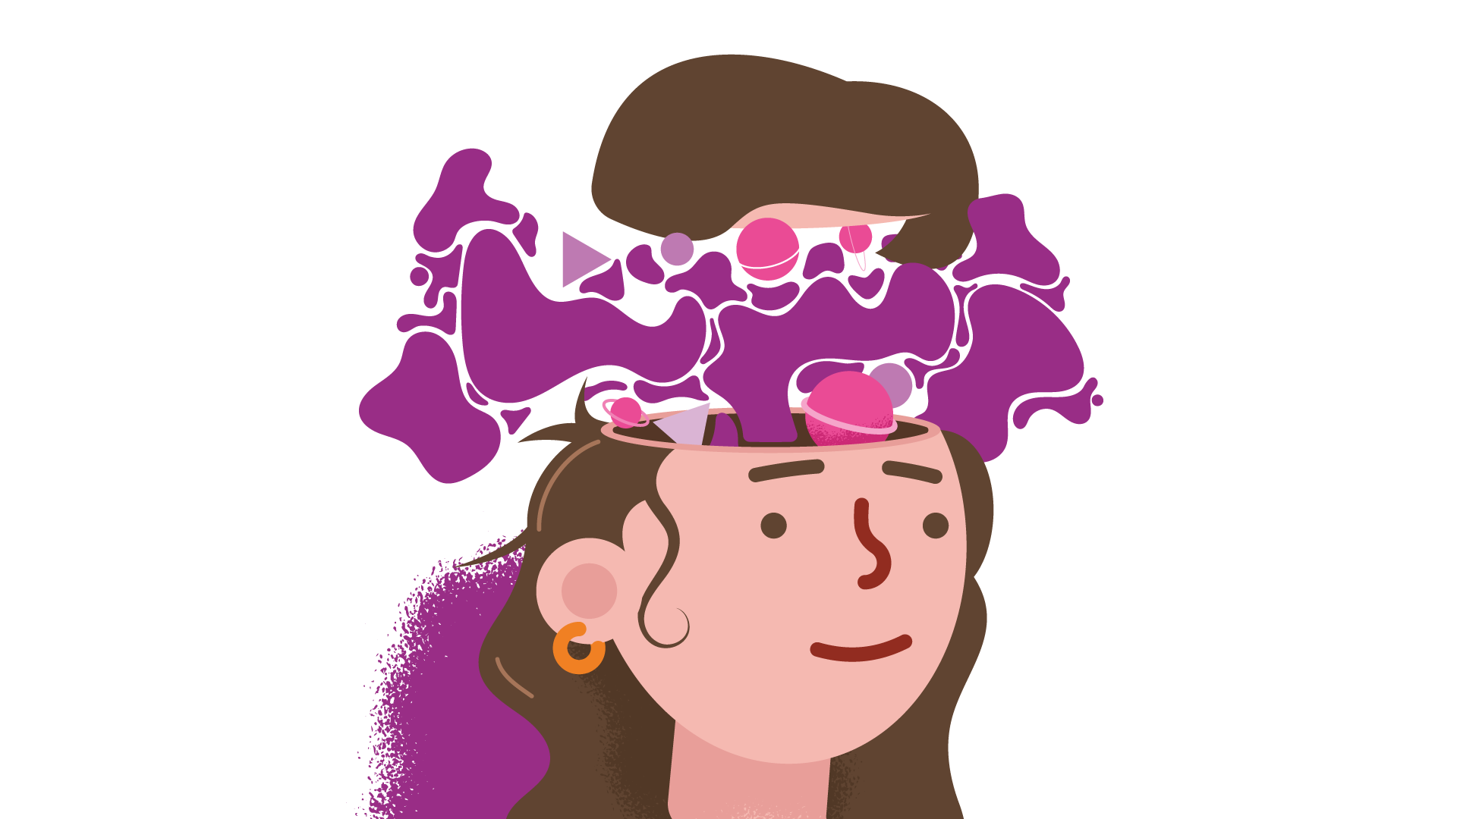
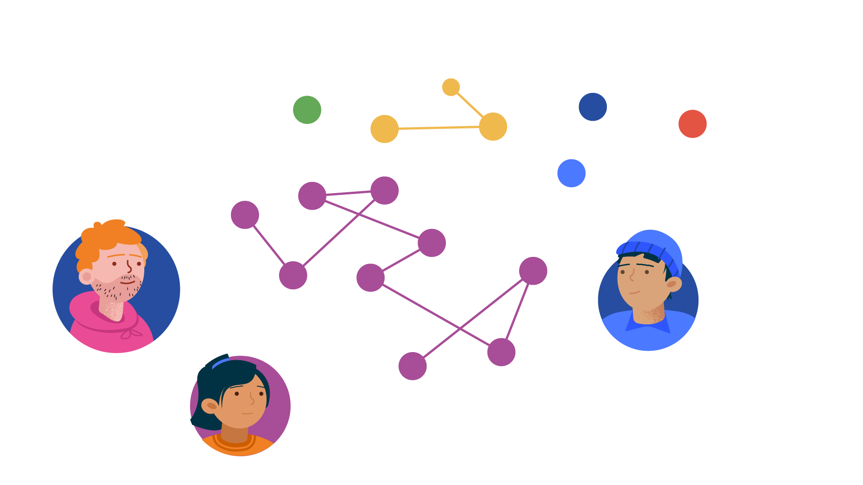

Resources to support IMPACT’s Change Model
Examples from practice
Helpful tools
Prompt sheet
Community of Practice

Slide 7
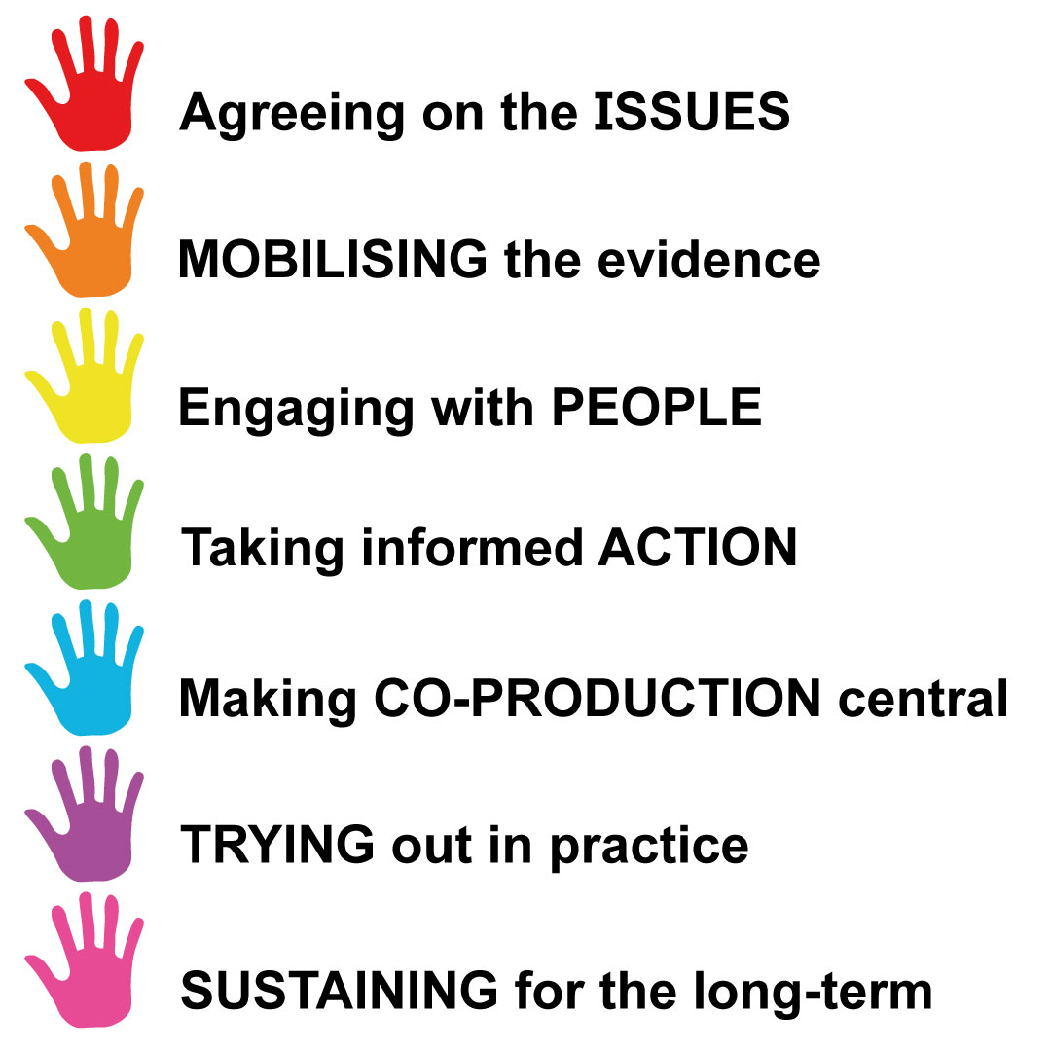
The Change Model
Notes:
Not a linear process – circular.

Slide 8
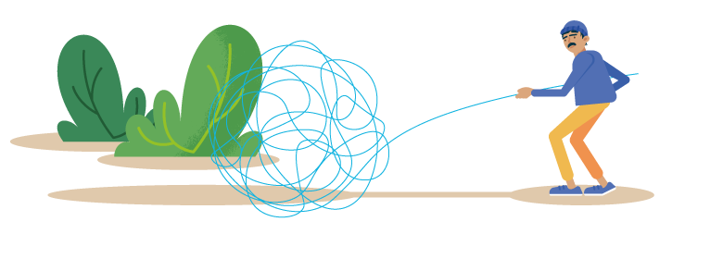
Agreeing on the ISSUES
Important that everyone understands the current situation, opportunities and challenges.
Consider what has been done before
Be clear about the outcomes you want to achieve, and what success would look like for different stakeholders.
Create a ‘safe’ environment for everyone to share their hopes, frustrations and concerns
Be open and honest about what can and can’t be changed
“Good support isn’t just about
‘services’ – it’s about having a life.”
Notes:
What is the issue/current situation
Important to know what has been tried before, but context may have changed, so may want to try something again
Outcomes
What can and can't be changed.

Slide 9

MOBILISING the evidence
Scarce time and resources should be focused on things that can make a real difference
Change should always be evidence-informed
Evidence should include research, lived experience and practice knowledge
Evidence should include diverse perspectives
Whilst gathering evidence, consider the risks of power imbalances, unheard voices and discriminatory bias
Different groups may value different types of evidence – e.g. stories, economic impact
Notes:
Evidence informed – evidence based practice, research culture in social care
Three type of evidence
Diverse perspectives – consider power imbalances etc.

Slide 10

Engaging with PEOPLE
It is important to build trust and respect through open and respectful communication
People with lived experience, carers and practitioners have felt let down in the past when change has been promised but has not materialised
Have a clear plan about listening, involving and responding to people
Reach agreement on what change is needed and possible
Involve ‘backroom’ or ‘technical’ stakeholders from the start (e.g. HR and IT) to avoid later obstacles
Notes:
People feeling let down, 'used', have given up their time for nothing.
Clear plan. Listen, involve, respond to people.
Involve backroom or technical stakeholders.

Slide 11

Taking informed ACTION
Good project management is crucial to turn inspiring plans into practical actions
It’s helpful to understand people’s assumptions behind why they think a particular action would work
Be realistic from the start about what change is feasible. This will help to avoid people becoming disillusioned later.
Regularly review the actions and assumptions behind them so plans can be adapted when needed
Notes:
Assumptions – why does someone think a particular approach or intervention would work?
Review and adapt – be flexible

Slide 12


Making CO-PRODUCTION central
Be honest about the level of engagement – if you are only able to ‘consult’ or ‘engage’, don’t call it co-production
Connect with people from different backgrounds and cultures, especially if they have been excluded previously
Co-production requires equal relationships and shared decision making – recognise where there are power imbalances
Be mindful that it takes time to develop open and trusting relationships
Ensure participants are kept informed about how their views influenced the change
“Good support isn’t just about
‘services’ – it’s about having a life.”
Notes:
Not going to comment on this – wait for the video!!

Slide 13

TRYING out in practice
Change approaches may need to be adapted depending on the context
At each stage be clear what aspect of the process is being explored
Be clear how the ‘trying out’ will be measured and understood
If something doesn’t work, encourage people not to see this as a ‘failure’ but an opportunity to reflect and learn
Using different types of data can be helpful (e.g. outcome measures, feedback from stakeholders)
Notes:
How will we measure and understand the change we are making
If something doesn't work – not a failure, is an opportunity to reflect and learn.
Different types of data – (depending on role) someone who is concerned about a measurable way of showing the impact vs someone who wants to hear what difference it has made to the people affected.

Slide 14

SUSTAINING for the long term
Planning for sustainable change from the beginning is vital
Connecting with other developments happening locally can help to ensure longer-term engagement and investment
Change involving diverse groups is more likely to be sustained due to increased energy and capacity
Evaluation insights can help build the credibility of the change
As the local context changes, the change approach may need to be adapted. Continue to focus on the outcomes that matter
Notes:
IMPACT projects – one year. Start thinking early on about how the organisation will sustain the change when IMPACT staff leave.
Involvement of diverse groups – increased energy and capacity.

Slide 15
Some examples from across IMPACT
Find more examples on the website here.
Notes:
Naomi to introduce. Change model in action.

Slide 16
Facilitator: Family Group Decision Making to Support People with Drug and Alcohol Issues (City of Edinburgh, Scotland)
Agreeing the issue
Low practitioner referrals. Why?
Mobilising evidence
Previous research
Building referrals takes time
Analysis of referrals so far
Biases: gender, had adult children
Most referrers familiar with FGDM by means other than team presentations
Speaking to other adult FGDM services
Importance of sharing success
Engaging a wide range of staff
Assumptions found:
There will be no (‘good’) family
Lack of understanding of FGDM
Loss of professional power
Not enough time for FGDM
Taking informed action
Improved information leaflet
Myth buster
Trying out in practice
Attendance at M/D recovery team allocation meetings

Slide 17
Network: People with learning disabilities and autistic people leaving long-stay hospitals
Agreeing the issue
Before the first Network meeting, IMPACT carried out an evidence review and found:
All four UK nations are characterised by alarmingly high levels of people with learning disabilities and autism admitted in long stay hospitals with an average stay of 3 years (and more).
Discharge plans are often delayed because of inadequate community services.
Surprisingly, there has been little research on why people with learning disabilities and autistic people spend so much time in these settings.
In particular, previous research often failed to speak directly to people with learning disabilities and autistic people, their families, or frontline staff about their experiences. As a result, key barriers and helpful solutions remain poorly understood.
Key learning:
Limited Housing Options
Poor Communication Between Services
Lack of Accountability to the Person
Not Seeing the Person as an Individual
People and Families Need a Stronger Voice
Lack of Information and Awareness
Funding Gaps
Staffing Challenges
Risk Aversion and Fear of Change
Institutional Environments Can Make Things Worse
Pressure to Act Quickly Can Backfire
Broken Trust

Slide 18
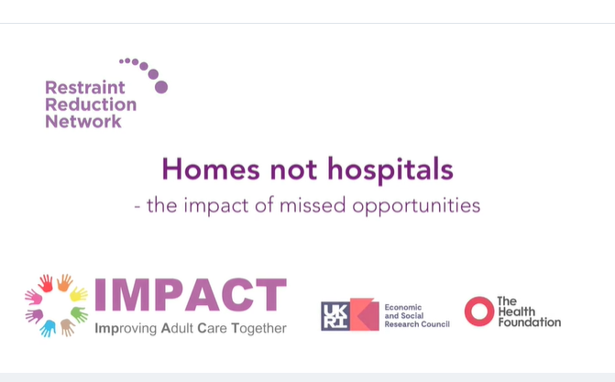
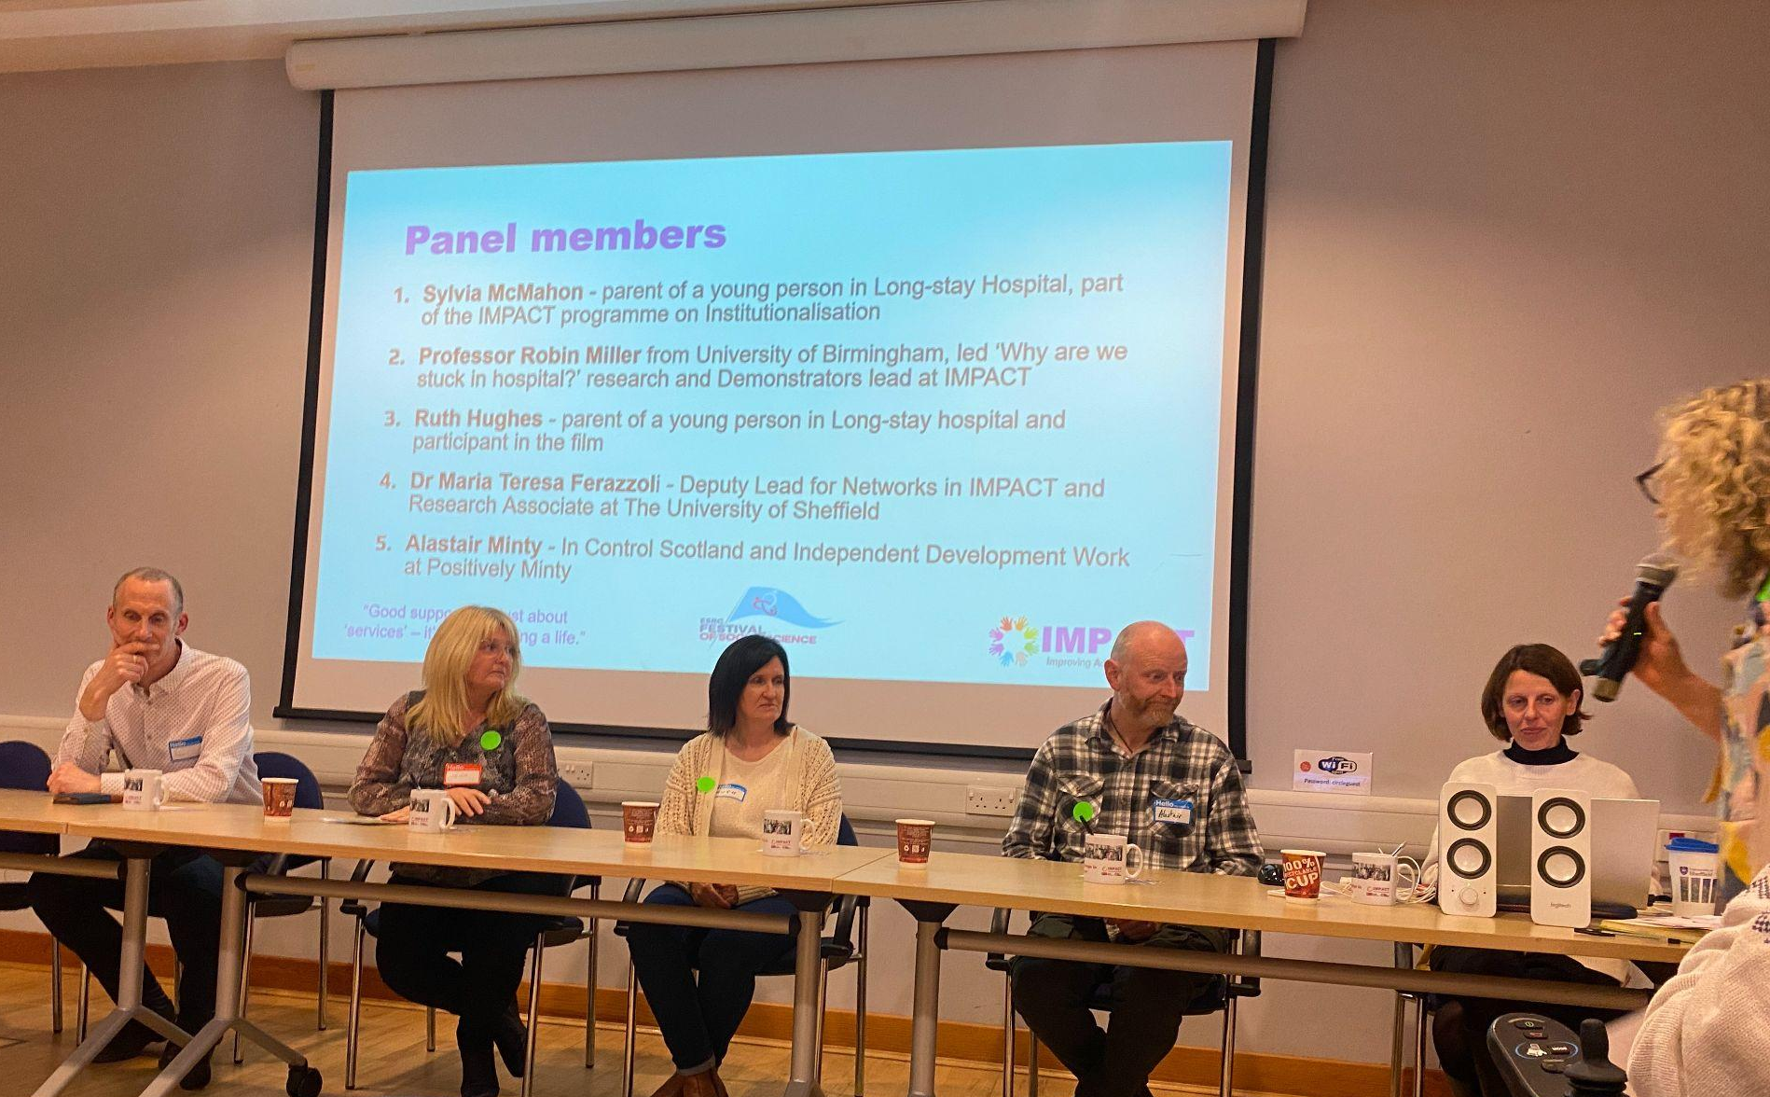
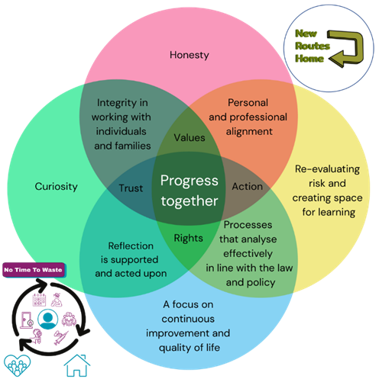
Network: People with learning disabilities and autistic people leaving long-stay hospitals
Mobilising evidence
Collective action: Awareness-raising campaign across all four UK nations
A co-produced video ‘Homes not hospitals’ has been produced and it has involved three of the networks (via BILD, MacIntyre and InControl Scotland). The video, which has been led by people with lived experience, is made across the four UK nations and includes the experiences of people with learning disabilities and autism and their carers.
Evidence-informed practices
One of the local Networks used the ‘top 10 tips’ to benchmark their own practice;
Co-produced 2 self-reflective toolkit
One for professionals,
One for individuals and families
The toolkit has also an Easy Read version

Slide 19
Demonstrator: Social work with older people (Walsall Council, England)
Making co-production central
People with lived experience had been involved in prior research
Equal members of steering group & workshops
Safe, inclusive & open space created
Co-production example to highlight good practice
Sustaining for the long term
Practitioner, Lived Experience & Strategic Leader engagement
Pilots to explore practical implementation
Connecting with wider council & NHS developments
On-going project support & coordination

Slide 20
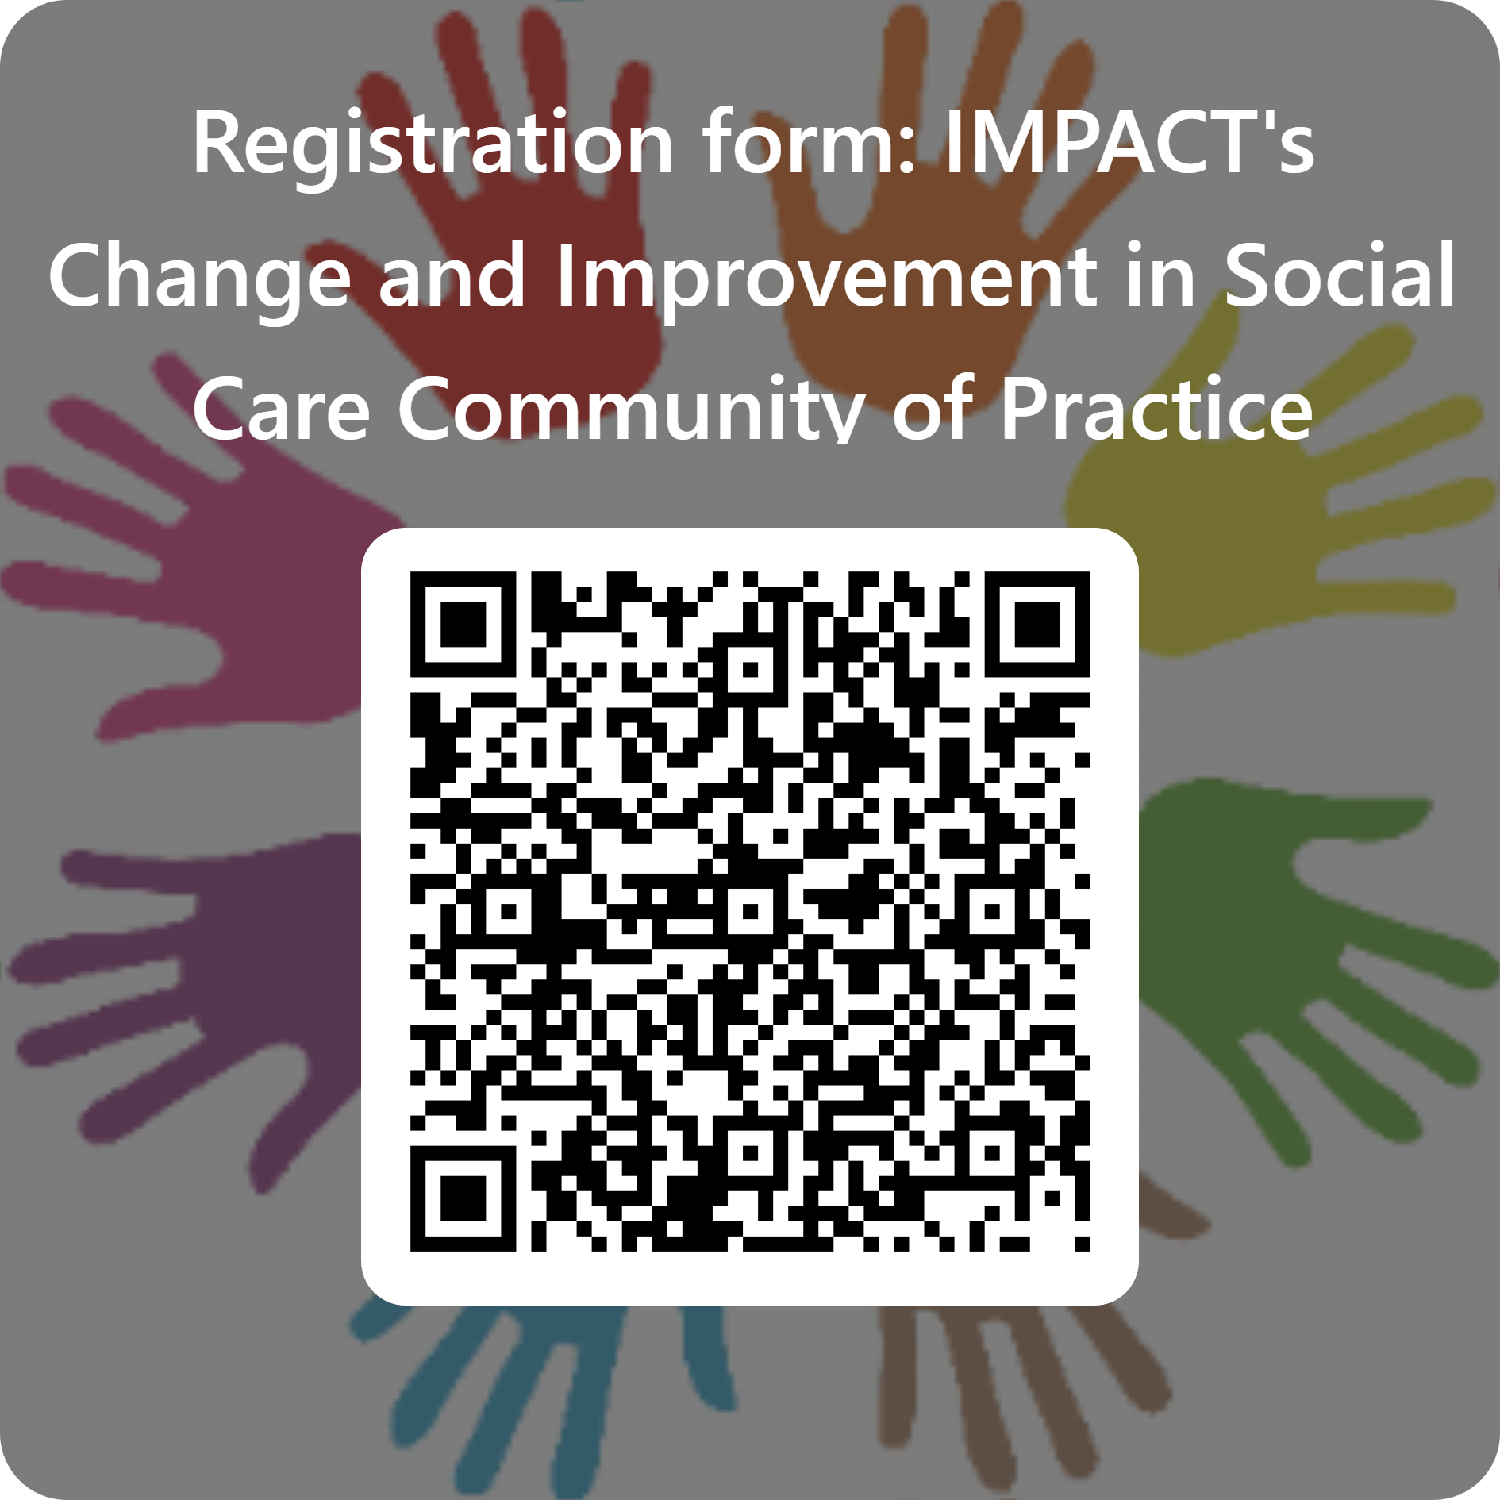
Community of Practice
Supportive space in which peers with an interest in change and improvement in social care can meet to share challenges, solutions and resources
Will meet every 6-8 weeks online for 90 minutes
Open to anyone in the UK who leads and / or facilities change and/or improvement projects and activities in social care
Activities including sharing of a local change and improvement projects, peer support re addressing barriers, identifying of helpful resources and research.

Slide 21
Find out more about our projects, people and progress:
https://impact.bham.ac.uk/
@ImpAdultCare

