Slide 1

Working in Social Care – True or false?

Slide 2
The social care work force is 21% male, 79% female
True
False

Slide 3
The social care work force is 21% male, 79% female
True
False

Slide 4
44% of adult social care workers are between 25-54 years-old
True
False

Slide 5
44% of adult social care workers are between 25-54 years-old
True
False

Slide 6
44% of adult social care workers are between 25-54 years-old
True
False
64% of adult social care workers are 25 – 54 compared to 48% of the general populations

Slide 7
51% of adult care workers do not hold a social care qualification
True
False

Slide 8
51% of adult care workers do not hold a social care qualification
True
False

Slide 9
Care worker pay has decreased in the last 10 years
True
False

Slide 10
Care worker pay has decreased in the last 10 years
True
False

Slide 11
Care worker pay has decreased in the last 10 years
True
False
Care worker pay has increased every year since 2016

Slide 12
In 2024, care workers were paid higher than the national living wage
True
False

Slide 13
In 2024, care workers were paid higher than the national living wage
True
False

Slide 14
In 2024, care workers were paid higher than the national living wage
True
False
In March 2024, the average hourly rate for care workers was £11.00, which is 58p higher than the national living wage

Slide 15
A registered nurse is paid more than a registered social worker
True
False

Slide 16
A registered nurse is paid more than a registered social worker
True
False

Slide 17
A registered nurse is paid more than a registered social worker
True
False
A registered nurse, on average, is paid £39,500 per year. A registered social worker is paid £41,500 per year

Slide 18
Last year, 1.59 million people worked in the adult social care sector
True
False

Slide 19
Last year, 1.59 million people worked in the adult social care sector
True
False

Slide 20
Social workers make up 20% of the adult social care workforce
True
False

Slide 21
Social workers make up 20% of the adult social care workforce
True
False

Slide 22
Social workers make up 20% of the adult social care workforce
True
False
Only 1% of the adult social care workforce are social workers

Slide 23
10% of UK social worker jobs are vacant (the position is unfilled, but someone is needed)
True
False

Slide 24
10% of UK social worker jobs are vacant (the position is unfilled, but someone is needed)
True
False

Slide 25
Between 2022-2023, the adult social care workforce grew by 1%
True
False

Slide 26
Between 2022-2023, the adult social care workforce grew by 1%
True
False

Slide 27
Activity Time ! ASC who are they and what do they do?

Slide 28
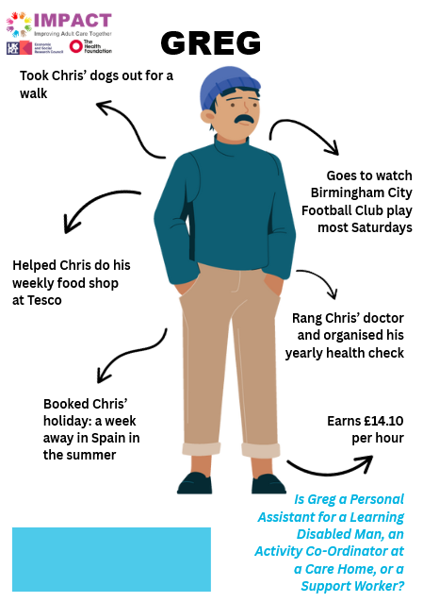


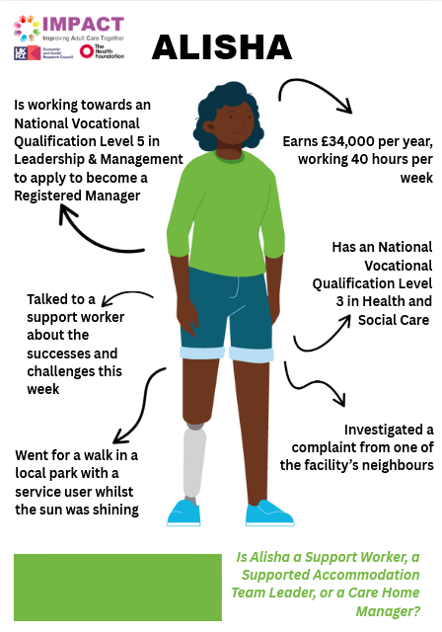
You have 15 minutes to work out what ASC job title they have…

Slide 29
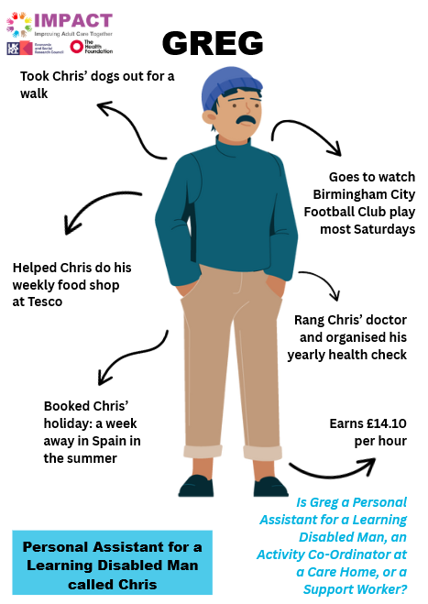

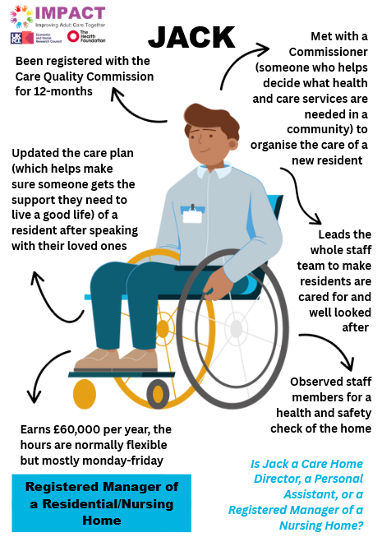
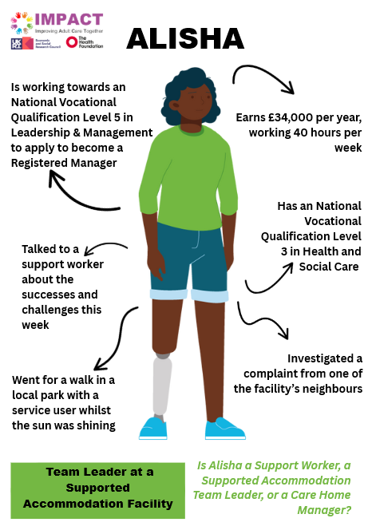

Slide 30




You have 15 minutes to pair the ASC weekly job tasks/characteristics with the job title…

Slide 31
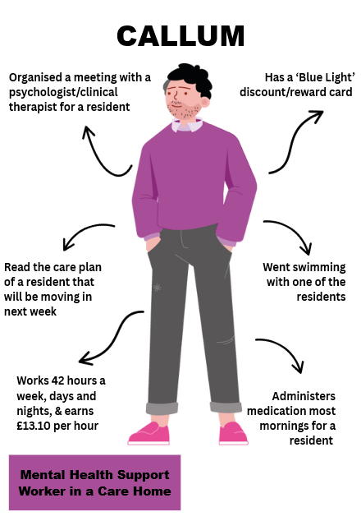
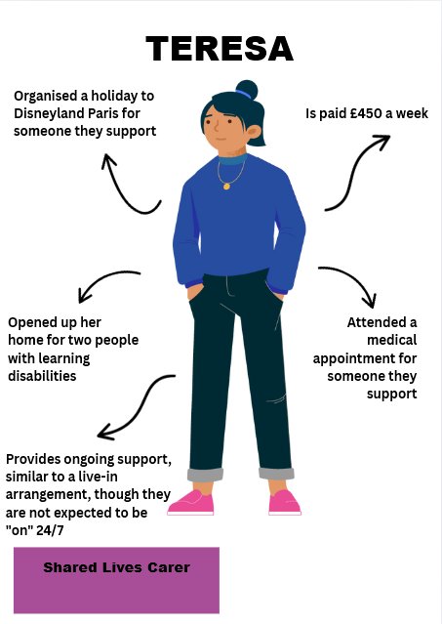

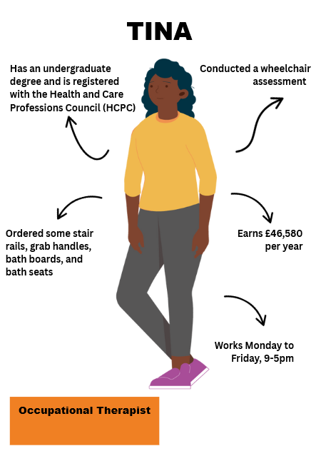

Slide 32
Time to reflect on working in Adult Social Care…

Slide 33
Find out more about our projects, people and progress:
https://impact.bham.ac.uk/
@ImpAdultCare

